Slide 1
Phylogenetics_Presentation_1_23
Kyle Johnson, Dell

Slide 2
R Markdown
This is an R Markdown presentation. Markdown is a simple formatting syntax for authoring HTML, PDF, and MS Word documents. For more details on using R Markdown see http://rmarkdown.rstudio.com.
When you click the Knit button a document will be generated that includes both content as well as the output of any embedded R code chunks within the document.

Slide 3
Tables SARs

Slide 4
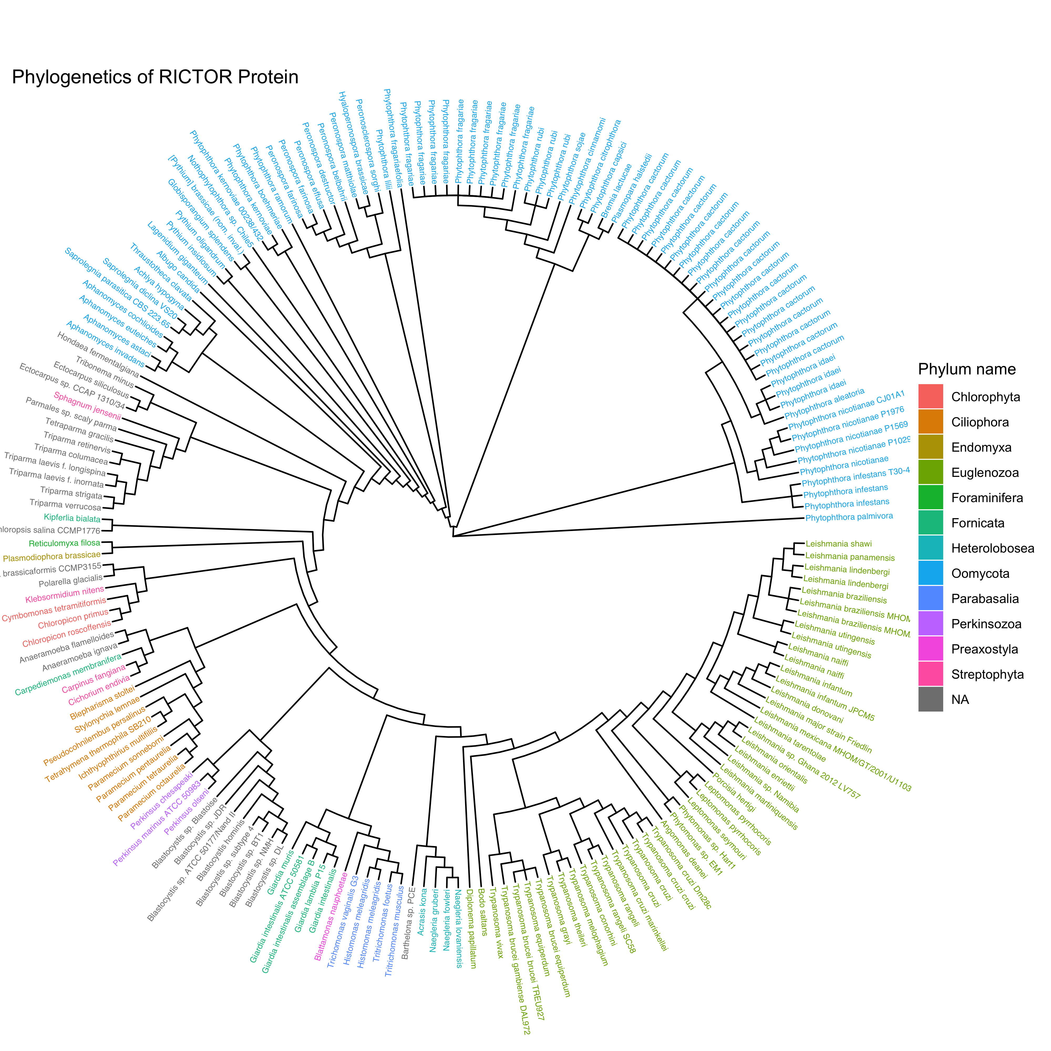
Combined Rictor Tree

Slide 5
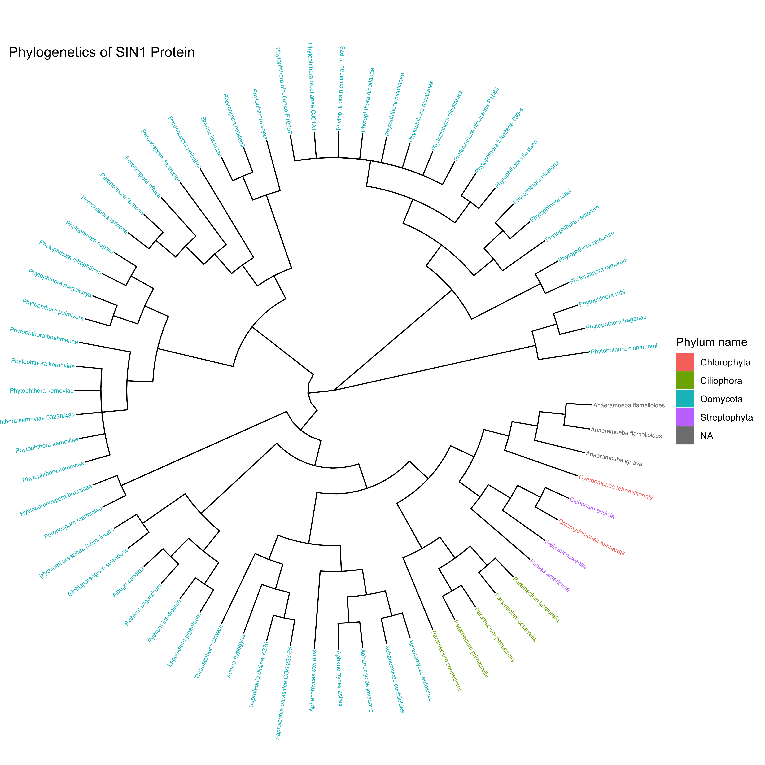
Combined SIN1 Tree

Slide 6
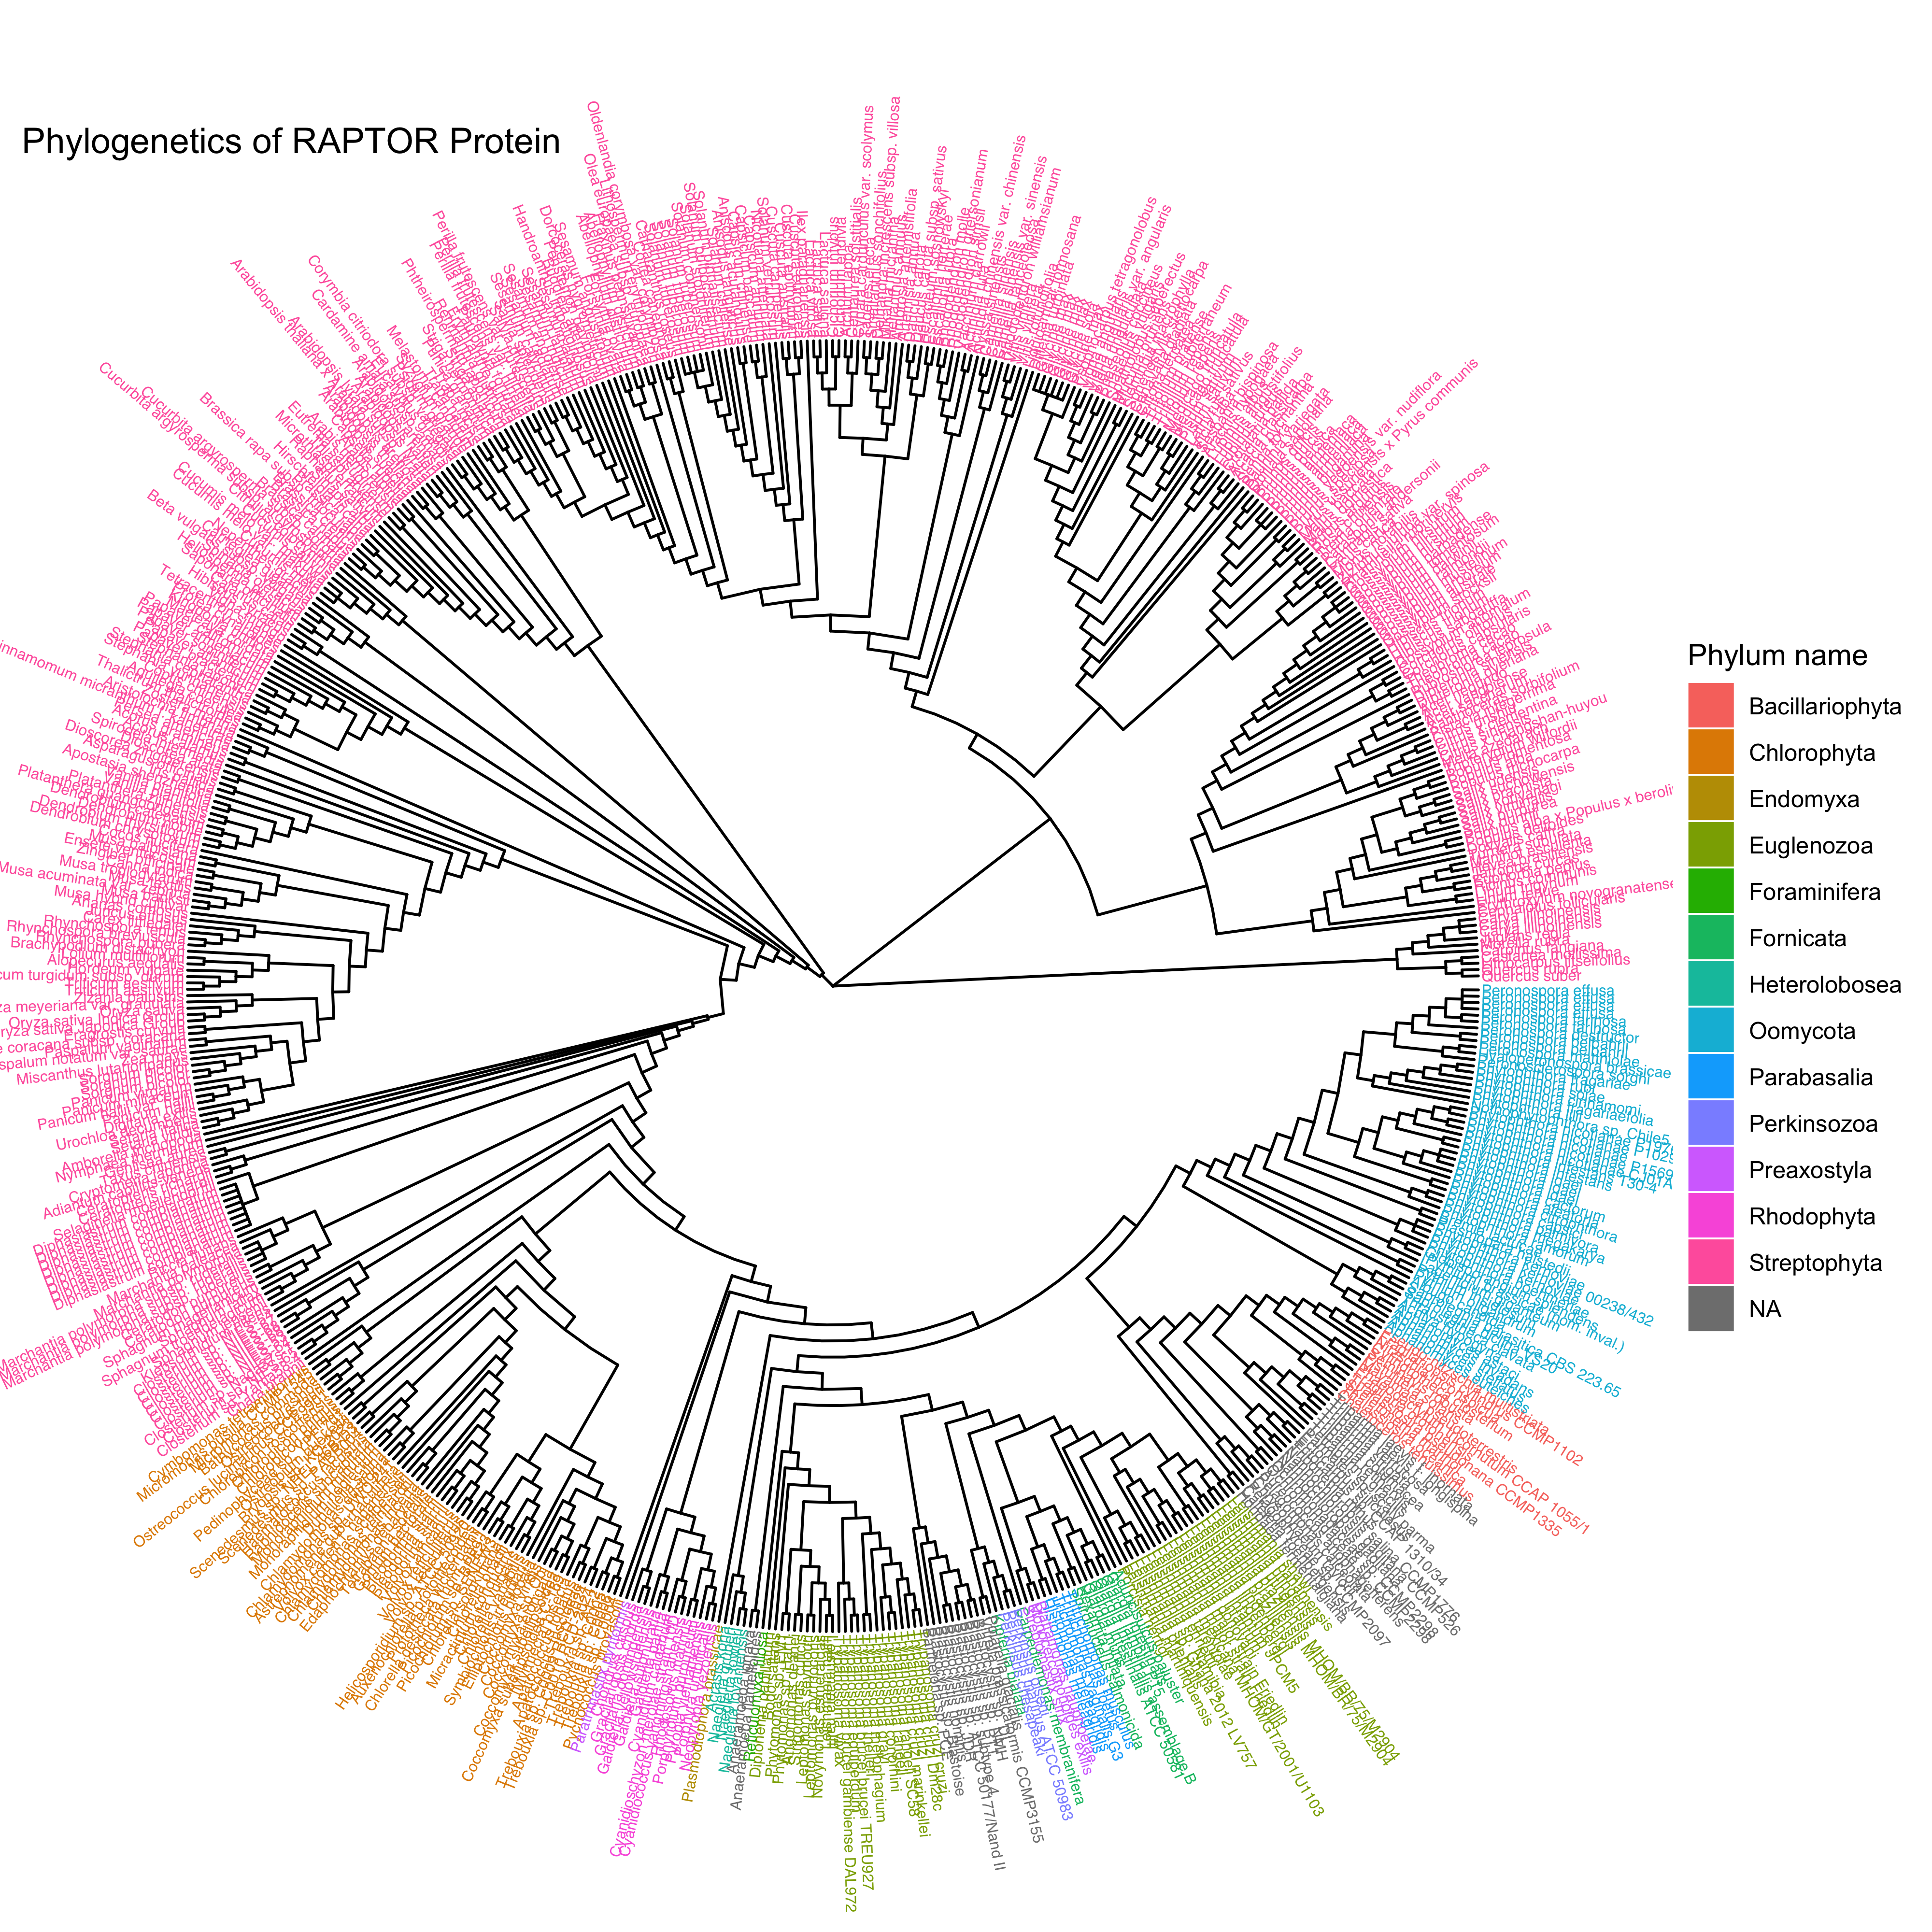
Combined RAPTOR Tree

Slide 7
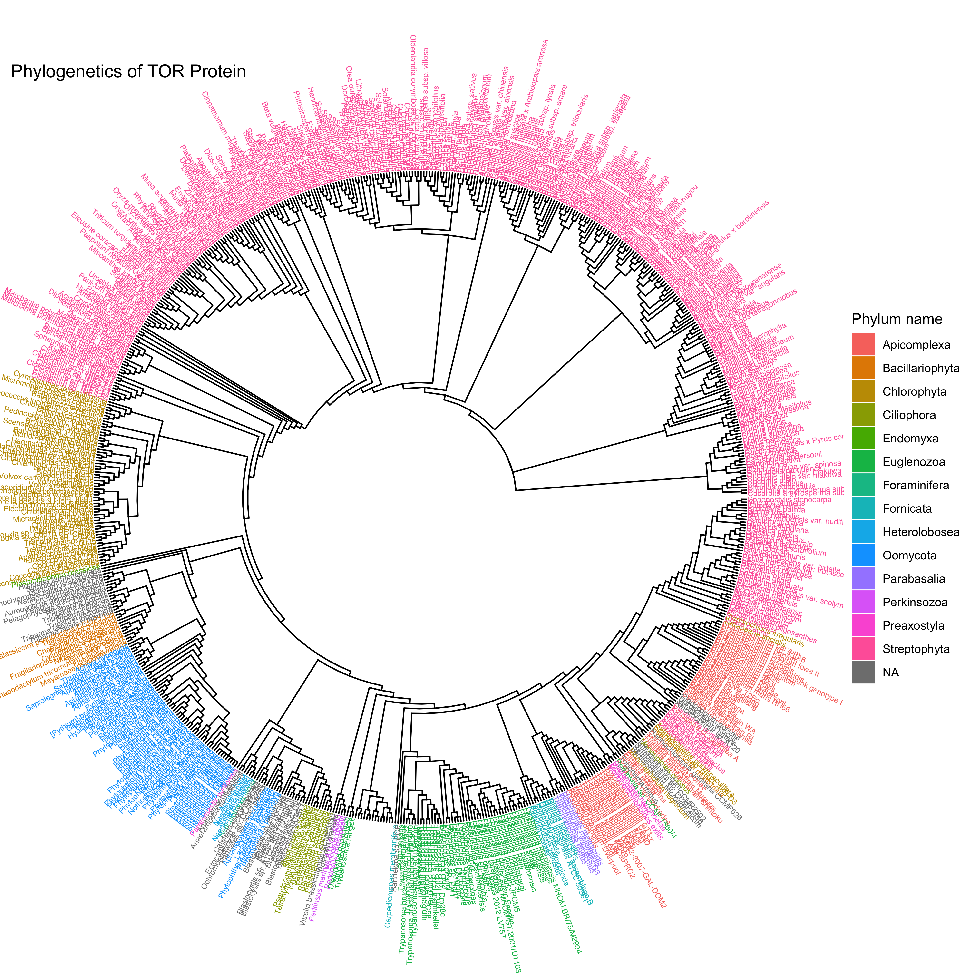
Combined TOR Tree

Slide 8
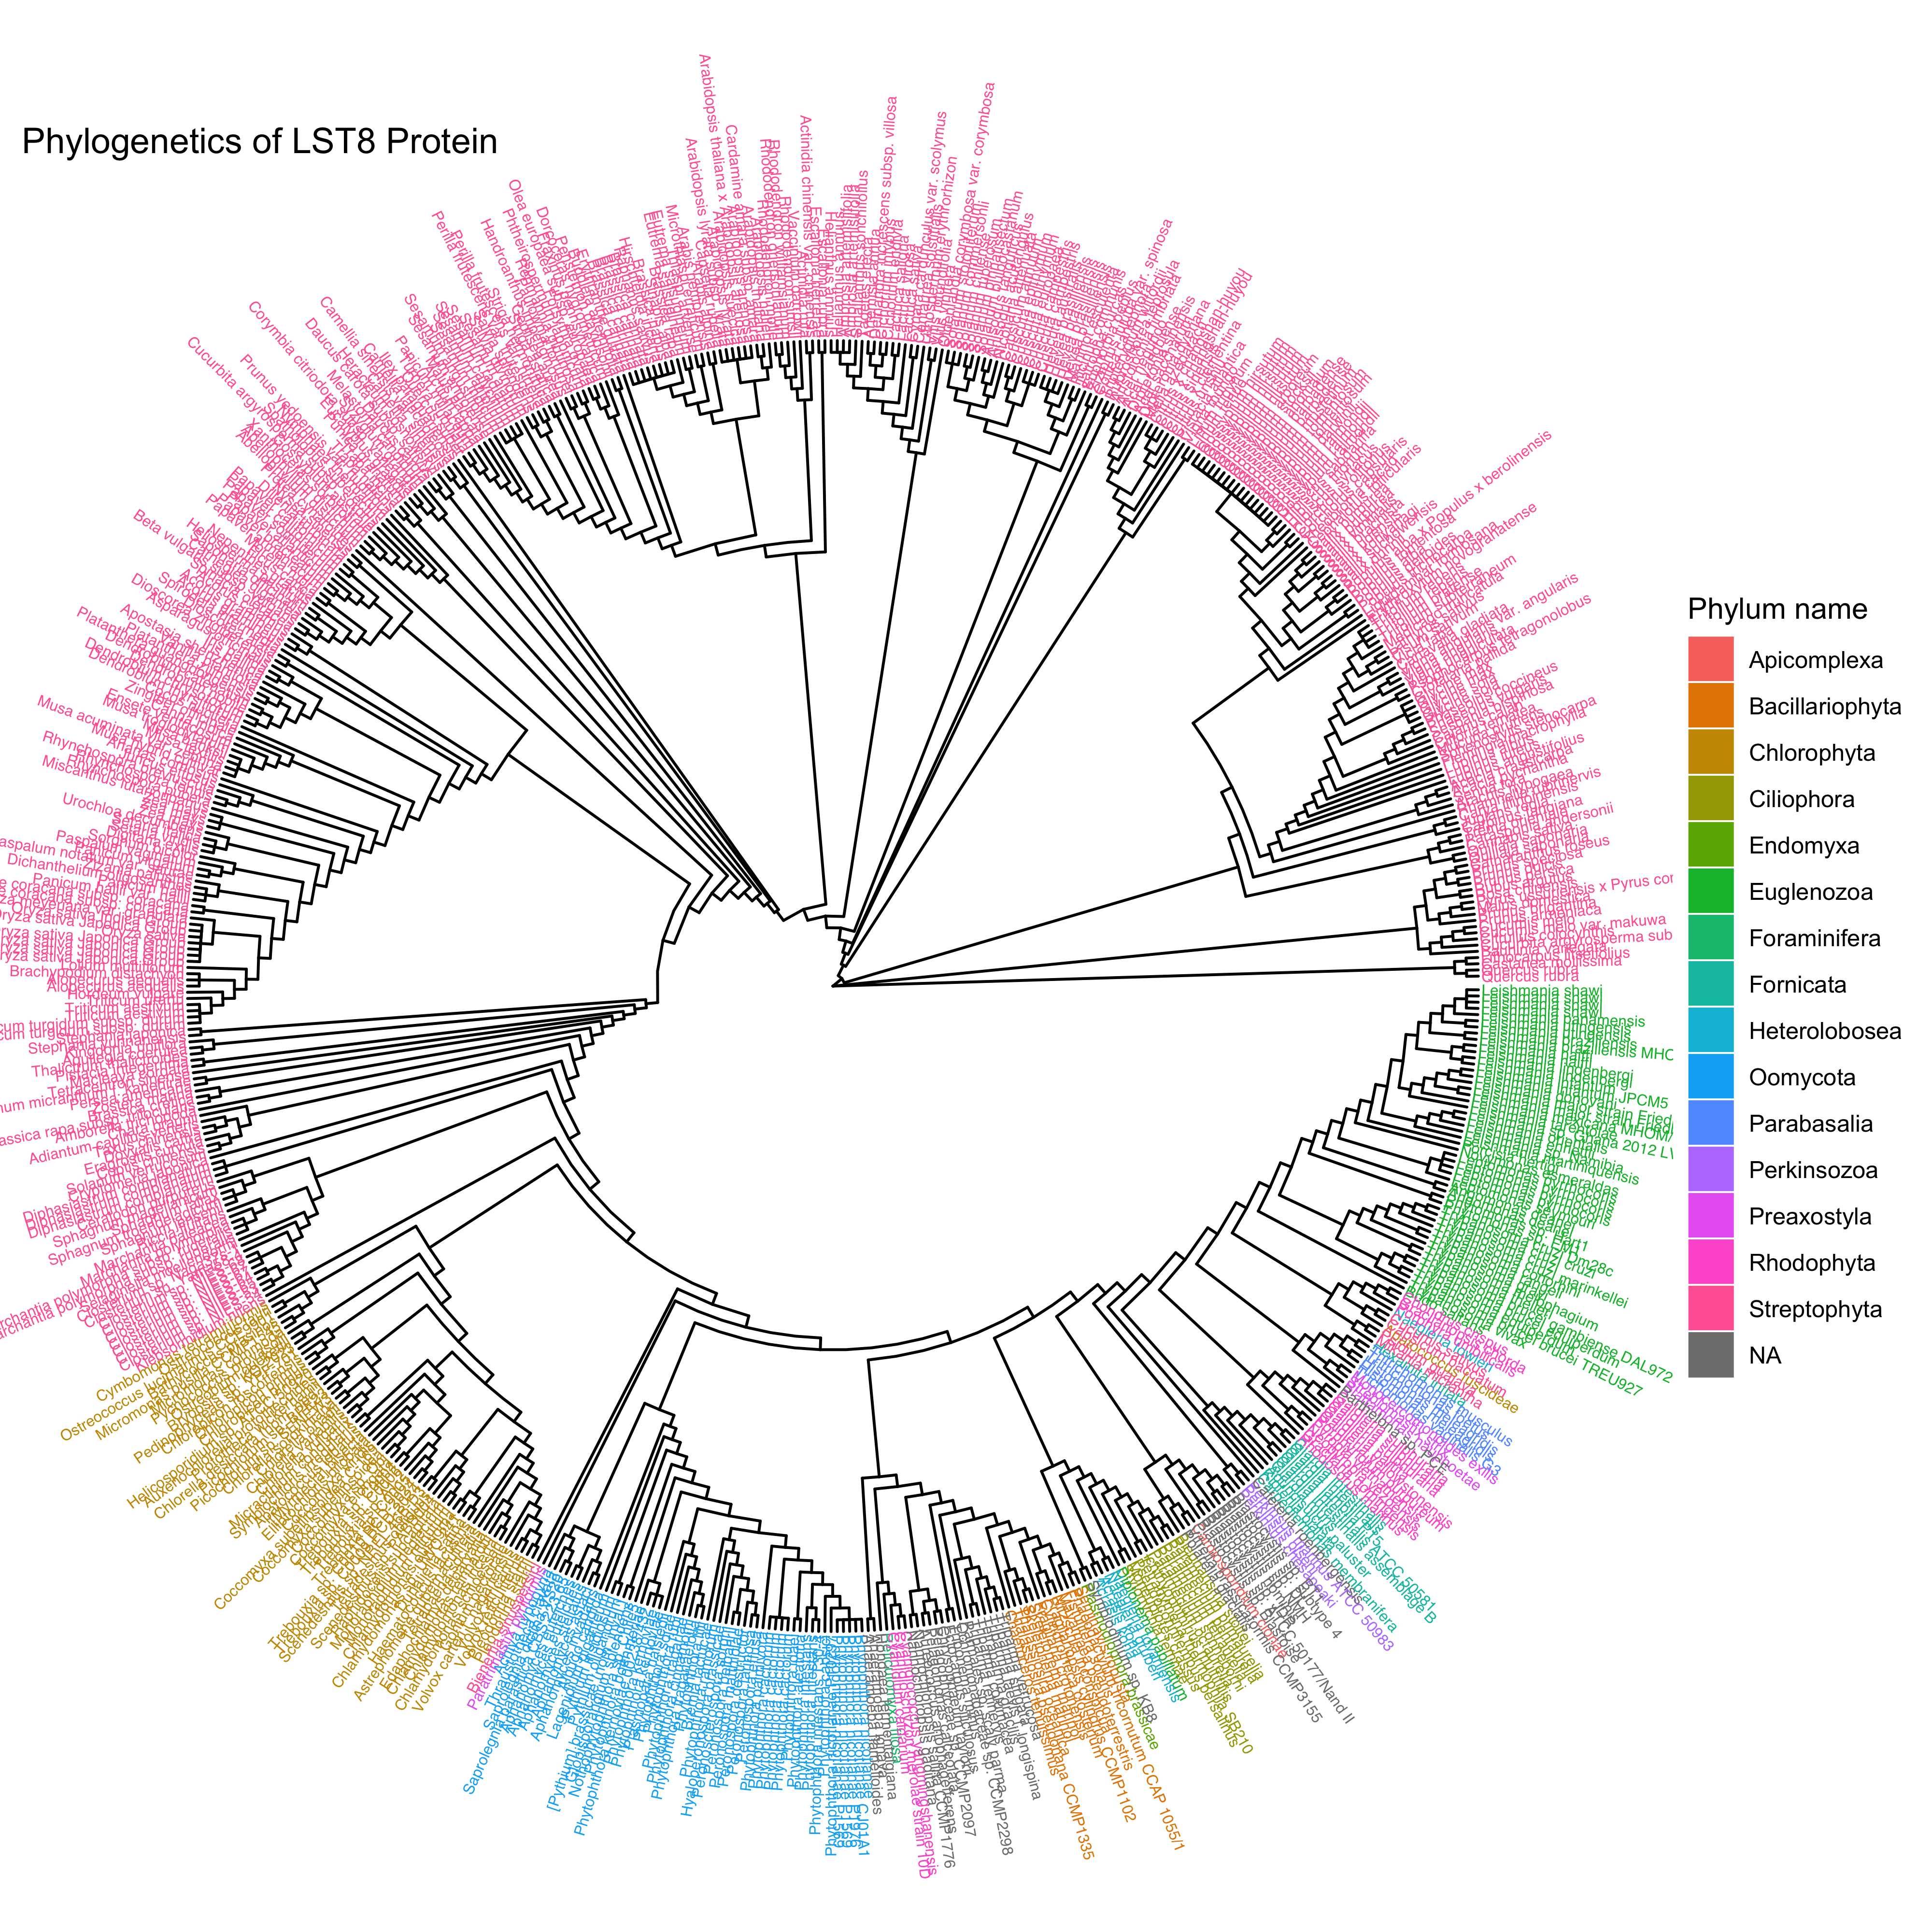
Combined LST8 Tree

